Slide 1
OOM MINI Project Online Movie Ticket Booking System
NOX Cinemas – your movie paradise

Slide 2
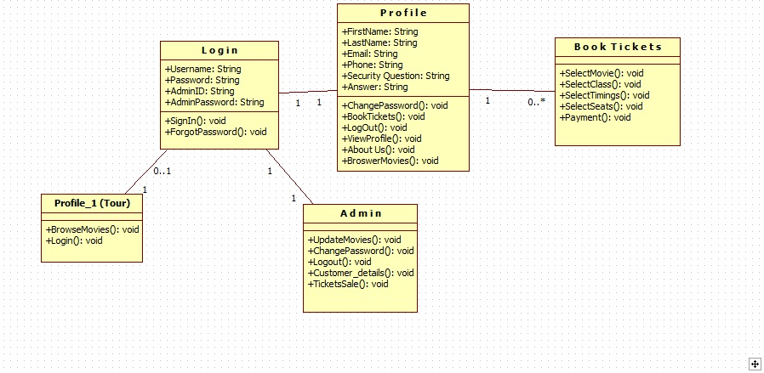
Class Diagrams

Slide 3
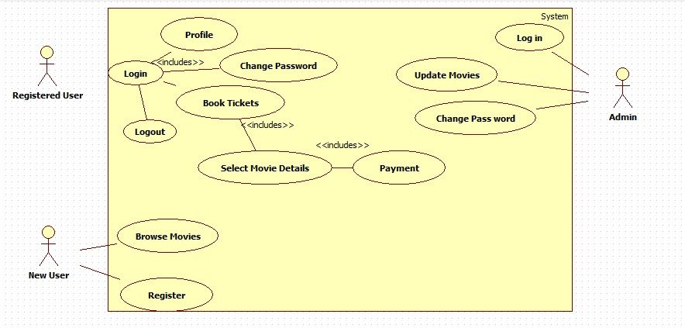
Use case Diagrams

Slide 4
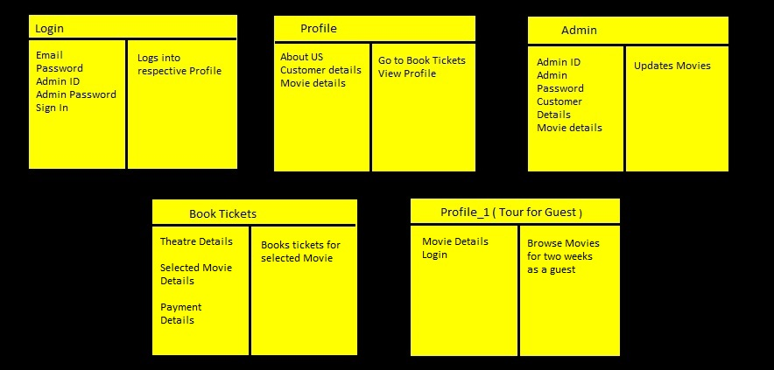
CRC Diagrams

Slide 5
Project Courtesy
Praneeth Daitha
Vamshi Krishna S
Prakhar Solanki

